Slide 1
UNIT 3
MULTIBIOMETRICS

Slide 2
TOPICS
Introduction to multibiometrics
Sources of multiple evidence
Acquisition sequence
Processing sequence
Fusion level
Sensor level fusion
Feature level fusion
Score level fusion
Rank level fusion
Decision level fusion

Slide 3
TOPICS
Features Matching and Decision Making
Feature matching: null and alternative hypothesis h0, h1, Error type I/II, Matching score distribution, FM/FNM, ROC curve, DET curve, FAR/FRR curve.
Introduction to Various matching methods
LDA
PCA, Eigen vectors and values, 2D-PCA,
generalization to p-dim, covariance and correlation, algebra of PCA, projection of data
Introduction to decision theory and their examples
Explanation – examples

Slide 4
Multibiometrics
Biometric systems can also be designed to recognize a person based on information acquired from multiple biometric sources.
Such systems, known as multibiometric systems, are expected to be more accurate compared to unibiometric systems that rely on a single piece of biometric evidence

Slide 5
ADVANTAGES
Availability of multiple biometric sources provides redundancy and fault-tolerance in the sense that the recognition system continues to operate even when certain biometric acquisition modules fail.
Alleviate the non-universality problem and reduce the failure to enroll errors. (For example, if a person cannot be enrolled in a fingerprint system due to worn-out ridge details or missing fingers he can still be identified using his other traits like face or iris.)
Increase the resistance to spoof attacks. This is because it becomes increasingly difficult to circumvent(avoid) multiple biometric sources simultaneously

Slide 6
ADV
Provide a degree of flexibility in user authentication. (Suppose a user enrolls into
the system using several different traits. Later, at the time of authentication, only a subset of these traits may be acquired based on the nature of the application under consideration and the convenience of the user.)
Enable the search of a large biometric database in a computationally efficient manner.

Slide 7
DISADV
It is more expensive than unibiometric systems due to the need for additional hardware (computational or storage resources) and larger enrollment and recognition times.
Multibiometric systems are being increasingly deployed in many large-scale identification systems involving millions of users (e.g., border control or national identity systems) because of their ability to achieve high recognition accuracy based on existing technologies, which far outweighs the additional cost in such applications

Slide 8
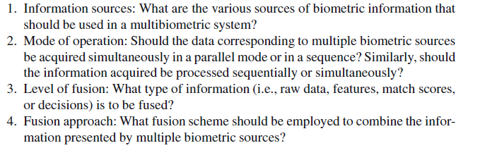
FOUR DESIGN ISSUES

Slide 9
Sources of Multiple Evidence
Based on the sources of evidence, multibiometric systems can be classified into
multi-sensor,
multi-algorithm,
multi-instance,
multi-sample,
and multimodal systems.

Slide 10
First four scenarios, multiple pieces of evidences are derived from a single biometric trait (e.g., fingerprint or iris), while in the fifth scenario (also called multimodal biometric system) multiple biometrictraits (e.g., fingerprint and iris) are used.
UID(Unique Identification Authority) system in India uses all ten fingers and
two irides, it is both multi-instance and multimodal. Such systems are called hybrid multibiometric systems.

Slide 11
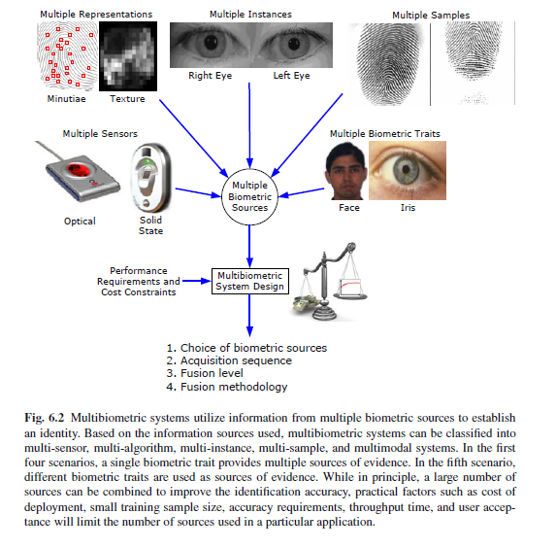

Slide 12
Multi-sensor systems
In these systems, a single biometric trait is imaged or captured using multiple sensors in order to extract diverse information.
For example, a system may record the two-dimensional texture content of a person’s face using a CCD camera and the three-dimensional surface shape (also called the depth or range image) of the face using a range sensor in order to perform authentication (see Figure 6.3)

Slide 13
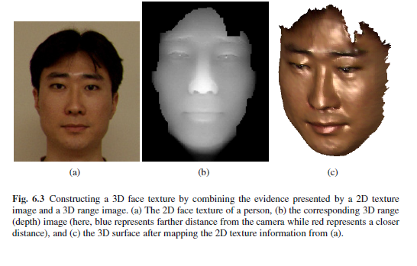
MULTI SENSOR

Slide 14
MULTI SENSOR
If an optical and a capacitive fingerprint sensor are used to capture fingerprints, the two fingerprint images can be processed independently without spatially registering them.
However,in this scenario, the user is required to interact with the sensors one at a time, leading to larger enrollment and verification times.

Slide 15
MULTI ALGORITHM
In these systems, the same biometric data is processed using multiple algorithms. For example, a texture-based algorithm and a minutiae-based algorithm can operate on the same fingerprint image in order to extract diverse feature sets that can improve the performance of the system.
This kind of system does not require the use of new sensors and, hence, is cost-effective.

Slide 16
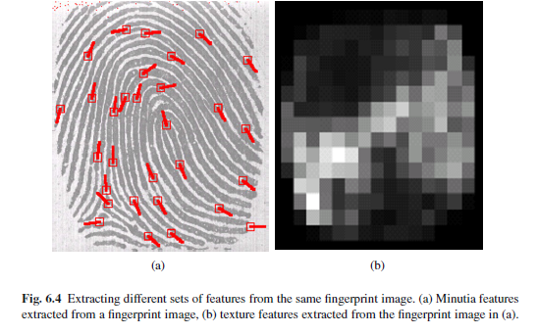
MULTI ALGORITHM
The main limitation of multi-algorithm systems is that since the different sources of evidence are obtained from the same raw data (e.g., right index fingerprint image), the multiple sources tend to be correlated

Slide 17
multi-algorithm system can use multiple feature sets (i.e., multiple representations) extracted from the same biometric data or multiple matching schemes operating on a single feature set.
Another example of a system using multiple feature sets is a face recognition system that employs different feature extraction schemes like Principal Component Analysis (PCA), Independent Component
Analysis (ICA), and Linear Discriminant Analysis (LDA) to encode (i.e., represent) a single face image.

Slide 18
Multi-instance systems
These systems use multiple instances of the same body trait and are also sometimes referred to as multi-unit systems
For example, the left and right index fingers, or the left and right irides of an individual may be used to verify an individual’s identity.
Automated Fingerprint Identification Systems (AFIS), that obtain tenprint information from a subject, can benefit from sensors that are able to rapidly acquire impressions of all ten fingers in three stages as shown in Figure 6.6.

Slide 19
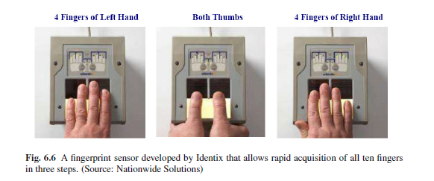

Slide 20
Multi-instance systems are often necessary in applications where the size of the system database (i.e., the number of enrolled individuals) is very large (the FBI’s IAFIS database currently has more than 60 million ten-print images) and all ten fingers provide additional discriminatory information that is required for high search accuracy.

Slide 21
Multi-sample systems
A single sensor may be used to acquire multiple samples of the same biometric trait in order to account for the variations that can occur in the trait, or to obtain a more complete representation of the underlying trait.
A face system, for example, may capture (and store) the left and right profile images along with the frontal image of a person’s face in order to account for variations in the facial pose

Slide 22
One of the key issues in amulti-sample system is determining the number of samples that need to be acquired from a biometric trait.
It is important that the procured samples represent the variability as well as the typicality of the individual’s biometric
data.

Slide 23
MULTIMODAL SYSTEMS
Multimodal systems combine the evidence presented by different body traits for establishing identity. Some of the earliest multimodal biometric systems utilized face and voice features to establish the identity of an individual.
The cost of deploying multimodal biometric systems is substantially more due to the requirement of multiple sensors and, consequently, the development of appropriate user interfaces

Slide 24
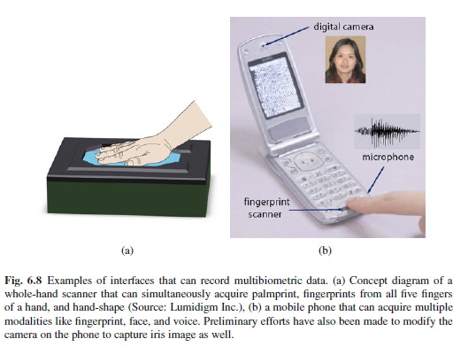

Slide 25
Acquisition and Processing Architecture
The order or sequence of biometric data acquisition has a bearing on the convenience imparted to the user.
The sequence in which the procured biometric data is processed can significantly impact the throughput time in large-scale identification systems

Slide 26
Acquisition sequence
The acquisition sequence in a multibiometric system refers to the order in which the various sources of evidence are acquired from an individual (in the case of multialgorithm systems, only a single biometric sample is required and, therefore, the acquisition methodology is not an issue).

Slide 27
SERIAL AND PARALLEL ACQUISITION
Typically, multibiometric systems employ the serial acquisition approach, where the evidence is gathered sequentially, i.e., each source is independently obtained with a short time interval between successive acquisitions.
In some cases, the evidence may be acquired simultaneously (in parallel fashion). For example the face and iris information of a user may be obtained nearly simultaneously by utilizing two cameras housed in the same unit.
Similarly, the face, voice, and lip movements of a user may be acquired simultaneously by capturing a video, and multiple fingerprints can be captured in parallel using a multi-finger slap scanner

Slide 28
Processing sequence
The processing sequence adopted by a multibiometric system refers to the order in which the acquired information is processed to render a decision which could be independent of the order in which the information is acquired.
Thus, information may be acquired sequentially but processed simultaneously and vice

Slide 29
Serial mode
In the serial or cascade mode, the processing of information takes place sequentially. In Figure 6.11, the fingerprint information of the user is first processed; if the fingerprint sub-system is unable to determine the user’s identity, then the data corresponding to the face biometric is processed.

Slide 30
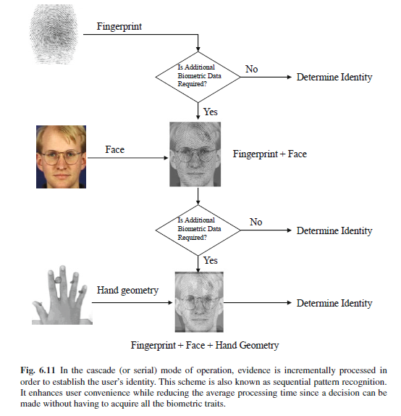
Serial mode of operation

Slide 31
Parallel
In the parallel mode, each unibiometric system processes its information independently at the same time and the processed information is combined using an appropriate fusion scheme (see Figure 6.12).
A multibiometric system designed to operate in the parallel mode generally has a higher accuracy because it utilizes more evidence about the user for recognition.
Most practical multibiometric systems have a parallel architecture because the primary goal of multibiometric system designers has been to reduce the error rates of biometric systems and not necessarily the throughput and/or processing time.

Slide 32
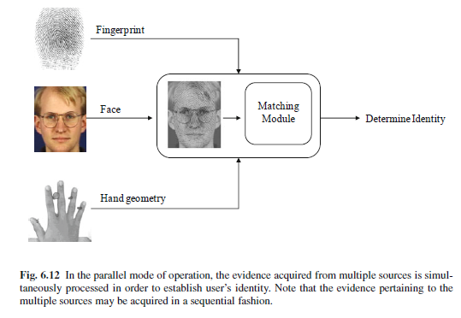
PARALLEL MODE OF OPERATION

Slide 33
HYBRID
It is also possible to have a hierarchical (tree-like) architecture to combine the advantages of both cascade and parallel architectures.
In such a scheme, a subset of the acquired modalities may be combined in parallel, while the remaining modalities may be combined in a serial fashion.
Such an architecture can be dynamically determined based on the quality of the individual biometric samples as well as when encountering missing biometric data.

Slide 34
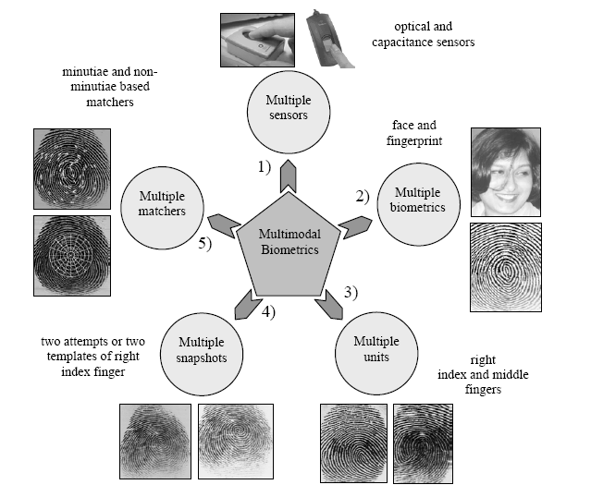

Slide 35
FUSION LEVELS
A fundamental issue in the design of a multibiometric system is to determine the type of information that should be consolidated by the fusion module.
In a typical biometric system, the amount of information available to the system gets compressed as one proceeds from the sensor module to the decision module (see Figure
6.13).

Slide 36
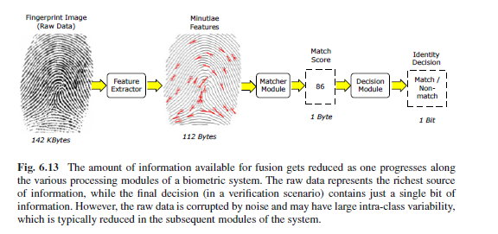
SIZE OF THE DATA IS REDUCED

Slide 37
BIOMETRIC FUSION
Multibiometric system, fusion can be accomplished by utilizing the information available in any of the four biometric modules (sensor, feature extractor, matcher, and decision modules).
Figure 6.14 shows the various levels of fusion possible in a multibiometric system. Biometric fusion can be broadly classified into (a) fusion prior to matching, and (b) fusion after matching.

Slide 38
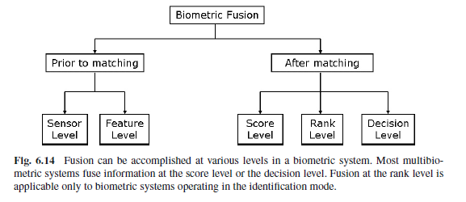
BIOMETRIC FUSION

Slide 39
PRIOR TO MATCHING &AFTER MATCHING
Prior to matching, integration of information from multiple biometric sources can take place either at the sensor level or at the feature level.
Schemes for integration of information after the classification/matcher stage can be further divided into three categories:
Fusion at the decision level,
Fusion at the rank level,
Fusion at the match score level.

Slide 40
COMPARISON
Biometric systems that integrate information at an early stage of processing are believed to be more effective than those systems that perform integration at a later stage.
Since the feature set contains richer information about the input biometric pattern than the match score or the decision label, integration at the feature level is expected to provide better recognition results than score or decision level fusion.

Slide 41
Different Fusion Strategies
Fusion prior to matching
Sensor level fusion
Feature level fusion
Fusion after matching
Match score fusion
Rank level fusion
Decision level fusion

Slide 42
Different Fusion Strategies (cont.)
Sensor level fusion
Raw data from the sensor(s) are combined.
This is referred to as image level or pixel level fusion.
Sensor level fusion can benefit multi-sample systems which capture multiple snapshots of the same biometrics.
For example, 2D face images of an individual obtained from several cameras can be combined to form a 3D model of the face.
Another example of sensor level fusion is the mosaicing of multiple fingerprint impressions of a subject in order to construct a more elaborate fingerprint image.

Slide 43
Sensor level fusion
Sensor level fusion can benefit multi sample systems which capture multiple snapshots of the same biometric.
Small fingerprint sensor may capture two or more impressions of a persons fingerprint and create a composite fingerprint image that reveals more of underlying ridge structure.this process is known as mosaicing.
Stiching algorithm is required to integerate various slices.
Mosaicing has been attempted by researchers in face recognition where multiple 2D images representing different poses are stiched to generate a single image

Slide 44
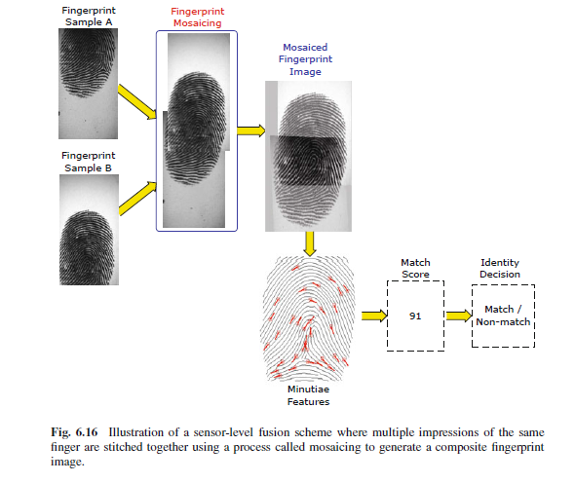
Sensor level Fusion

Slide 45
SENSOR level

Slide 46
Different Fusion Strategies (cont.)
Feature level fusion
It refers to combine different feature sets extracted from multiple biometric sources.
When feature sets are homogeneous, a single resultant feature vector can be calculated as a weighted average of the individual feature vector
When the feature set are non-homogeneous , we can concatenate to form a single feature vector.
Sometime concatenation may not be possible (Fingerprint minutiae and Eigen-face coefficient)

Slide 47
Feature level sensor
Feature-level fusion schemes can be categorized into two broad classes, namely,
homogeneous and heterogeneous.
A homogeneous feature fusion scheme is used when the feature sets to be combined are obtained by applying the same feature extraction algorithm to multiple samples of the same biometric trait (e.g., minutia sets from two impressions of the same finger). This approach is applicable tomulti-sample and multi-sensor systems.
Heterogeneous feature fusion techniques are required if the component feature sets originate from different feature extraction algorithms or from samples of different biometric traits (or different instances of the same trait).

Slide 48
Homogeneous feature fusion
Homogeneous feature fusion can be used for template update or template improvement.
Template update: A template in the database can be updated based on the evidence presented by the current feature set in order to reflect (possibly) permanent changes in a person’s biometric.
A simple scheme would be to take average of two feature vectors corresponding to two instances of biometric signal and use the average feature vector as the new template

Slide 49
Template improvement: In the case of fingerprints, the minutiae information available in two impressions can be combined by appropriately aligning the two prints and then removing duplicate minutia, thereby generating a larger minutia set (see Figure 6.18).
This process, known as template improvement, can also be used to remove spurious minutiae points that may be present in a feature set.
While template update is used to accommodate temporal changes in a person’s biometric, the purpose of template improvement is to increase the number of features (and decrease the number of spurious features) whilst retaining its integrity

Slide 50
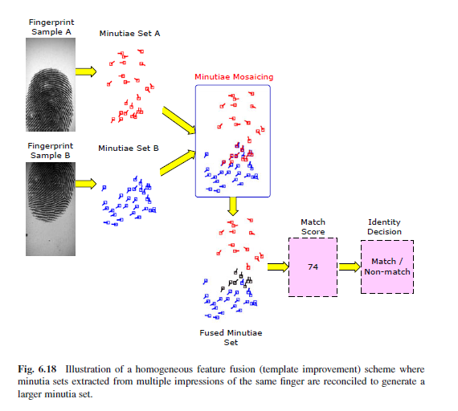
Homogenous feature fusion

Slide 51
Heterogeneous feature fusion
How does one consolidate feature sets originating from different algorithms and different biometric modalities?
Feature level fusion is difficult to achieve in such cases because of the following reasons:
The relationship between the feature spaces of different biometric systems may not be known.
The feature sets of multiple modalities may be incompatible. For example, the minutiae set of fingerprints and the eigen-coefficients of face have different representation schemes.
Concatenating two feature vectors might lead to the curse-of-dimensionality problem, where increasing the number of features might actually degrade the system performance especially in the presence of small number of training samples. The curse of dimensionality basically means that the error increases with the increase in the number of features
Most commercial biometric systems do not provide access to the feature sets used in their products due to proprietary reasons.

Slide 52
Heterogenous
To avoid the above said issue follow the
Feature Normalization
Feature Selection or Transformation
The main purpose of feature normalization is to modify the location and scale parameters of individual feature values to transform the value into a common domain.

Slide 53
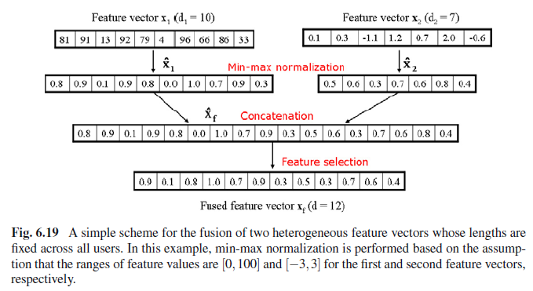
Min max normalization

Slide 54
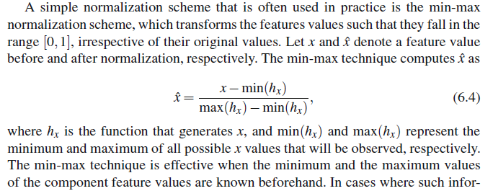
Min max

Slide 55
Feature normalization
The goal of feature normalization is to modify the location (mean) and scale (variance) of the features values via a transformation function in order to map them into a common domain.
Adopting an appropriate normalization scheme also helps address the problem of outliers in feature values.

Slide 56
Feature selection scheme
Feature selection is a dimensionality reduction scheme that entails choosing a minimal feature set of size d, d <(d1+d2), such that a criterion (objective) function applied to the training set of feature vectors is optimized.

Slide 57
Different Fusion Strategies (cont.)
Features are normalized
Feature selection schemes are employed to reduce the dimension size of the feature vector
Principal Component Analysis (PCA)
Linear Discriminant Analysis (LDA)

Slide 58
Different Fusion Strategies (cont.)
Score level fusion
Scores generated from different matching modules are combined to produce a single score.
Final decision is taken by considering the fused score.
Normalization and Similarity/ Dissimilarity Score
There are various approaches possible for combining the individual scores.
Product rule
Sum rule
Weighed sum rule
Max rule and median rule

Slide 59
Score level
When match scores output by different biometric matchers are consolidated in order to arrive at a final recognition decision, fusion is said to be done at the score level.
This is also known as fusion at the measurement level or confidence level.
After the raw data and feature vectors representations, the next level of fusion is based on match scores.
It is relatively easy to access and combine the scores generated by different biometric matchers.
Consequently, score-level fusion is the most commonly used approach in multibiometric systems

Slide 60
Score-level fusion methodologies will vary depending on whether the multibiometric system operates in the verification or identification mode.
Score fusion in a multibiometric verification system can be considered as a two-class pattern classification problem, where the goal is to determine whether the query corresponds to a “genuine” user or an “impostor”.

Slide 61
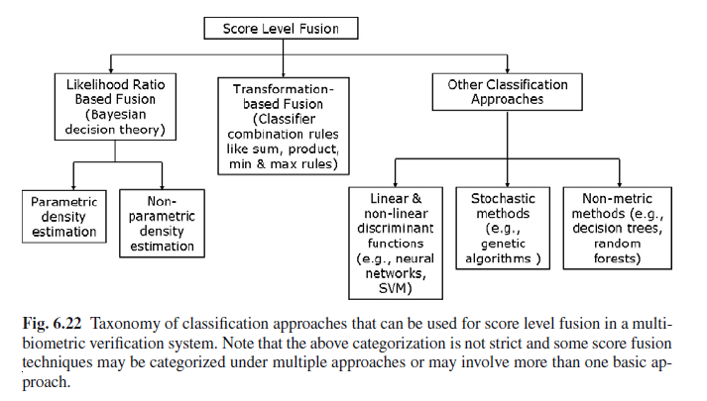

Slide 62
Different Fusion Strategies (cont.)
Rank level fusion
For identification, output is the ranks of enrolled identities.
This fusion scheme is to consolidate the ranks of individual biometric systems to derive a fused rank for each identity.
It reveals less information than match scores. However, unlike match scores, the ranking output by multiple biometric systems are comparable.
No normalization is needed and this makes the rank level fusion schemes simpler to implement compared to the score level fusion techniques.
Highest rank method
Logistic regression method

Slide 63
Rank method
When a biometric system operates in the identification mode, the output of the system can be viewed as a ranking of the enrolled identities.
The goal of rank-level fusion schemes is to consolidate all the ranks output by the individual biometric subsystems in order to derive a consensus rank for each identity.
Ranks provide more insight into the decision-making process of the matcher compared to just the identity of the best match, but they reveal less information than match score

Slide 64
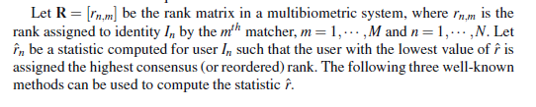
Rank method

Slide 65
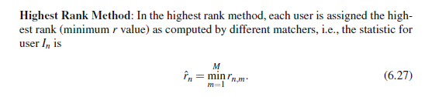
Highest rank

Slide 66
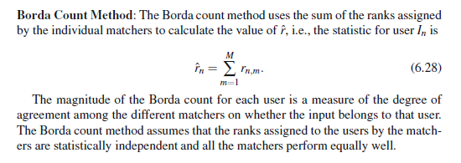
Borda count

Slide 67
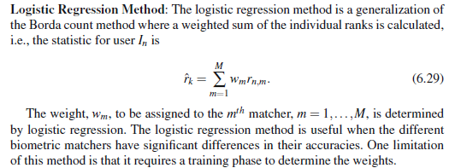
Logistic regression

Slide 68
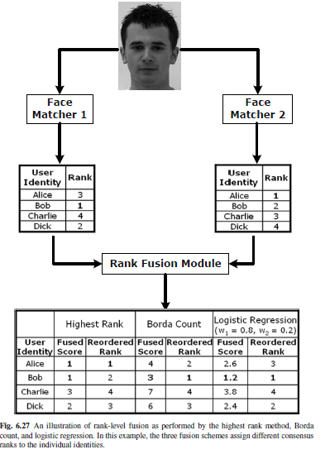
Rank all three methods

Slide 69
Different Fusion Strategies (cont.)
Decision level fusion
Decision level fusion is the highest level fusion of biometric evidences.
Fusion is carried out at the abstract or decision level when only the decisions output by the individual biometric matchers are available.
It logically combines accept/reject matching decisions of different matchers.
“AND” and “OR” rule
Majority voting
Weighted majority voting
Bayesian decision fusion

Slide 70
DECISION LEVEL
Many commercial off-the-shelf (COTS) biometric matchers provide access only to the final recognition decision.
When such COTS matchers are used to build a multibiometric system, only decision-level fusion is feasible.
Decision-level fusion include “AND” and “OR” rules, majority voting, weighted majority voting, Bayesian decision fusion, the Dempster-Shafer theory of evidence, and behavior knowledge space.

Slide 71
“ AND” and “OR” Rules
In a multibiometric verification system, the simplest method of combining decisions output by the different matchers is to use the AND and OR rules.
The output of the AND rule is a “match” only when all the M biometric matchers agree that the input sample matches with the template.
On the contrary, the OR rule outputs a “match” decision as long as at least one of the M matchers decides that the input sample matches with the template.
The limitation of these two rules is their tendency to result in extreme operating points.
When the AND rule is applied, the False Accept Rate (FAR) of the multibiometric system is extremely low (lower than the FAR of the individual matchers) while the False Reject Rate (FRR) is high (greater than the FRR of the individual matchers).
The OR rule leads to higher FAR and lower FRR than the individual matchers.
When one biometric matcher has a substantially higher equal error rate compared to the other
matcher, the combination of the two matchers using AND and OR rules may actually degrade the overall performance.
Due to this phenomenon, the AND and OR decision fusion rules are rarely used in practical multibiometric systems.

Slide 72
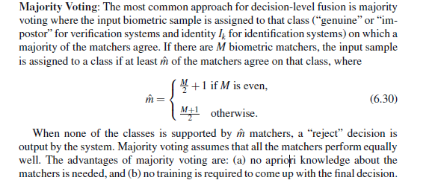
MAJORITY VOTING

Slide 73
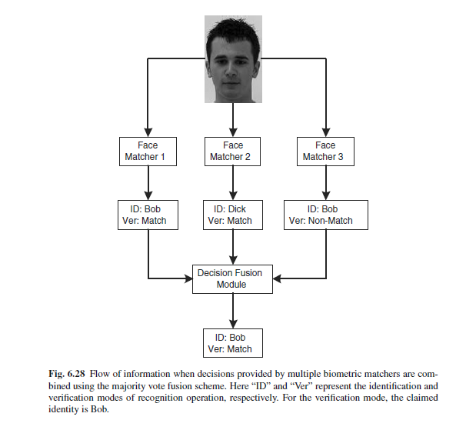
MAJORITY VOTING

Slide 74
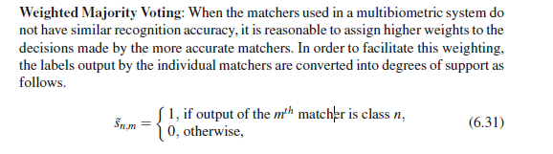
Weighted Majority Voting

Slide 75
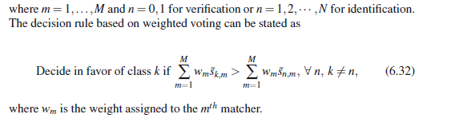
weighted

Slide 76
Bayesian decision
Bayesian decision fusion scheme relies on transforming the discrete decision labels output by the individual matchers into continuous probability values.

Slide 77
Feature Matching and Decision Making
Feature matching: null and alternative hypothesis h0, h1, Error type I/II, Matching score distribution, FM/FNM, ROC curve, DET curve, FAR/FRR curve.
for FAR,FRR,FM,FNM ROC refer unit 1 slides

Slide 78
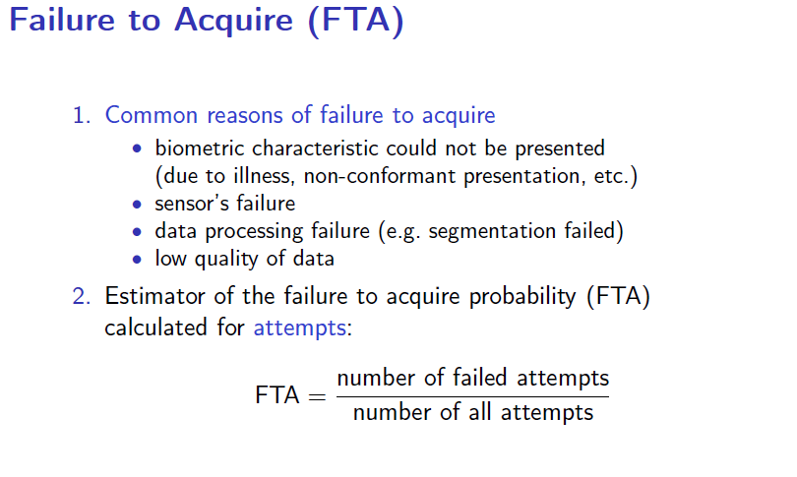
errors

Slide 79
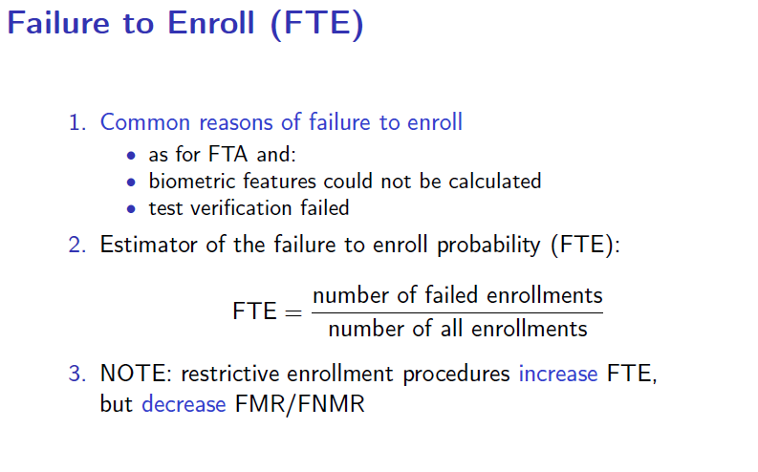

Slide 80
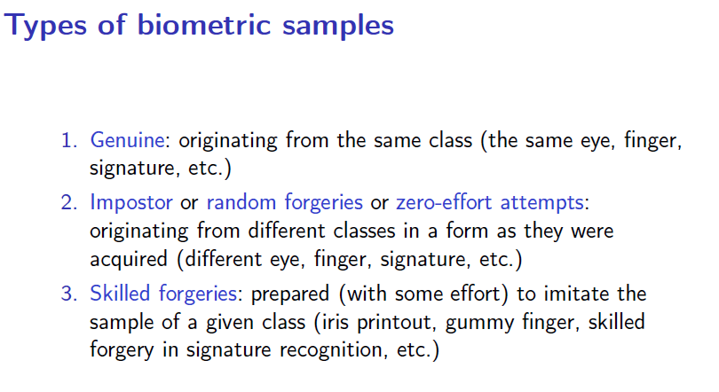

Slide 81
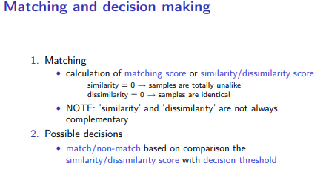

Slide 82
Kinds of errors
Given two biometric samples we can have two possible hypothesis
-Null hypothesis H0 => two samples are matching
- Alternative hypothesis H1 => two samples are not matching
Definition of hypothesis depends on biometric applications.
- different application can have different definition of errors.
But matching engine decides whether H0 is true or H1 is true.

Slide 83
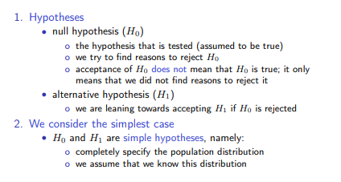

Slide 84
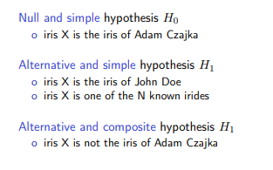

Slide 85
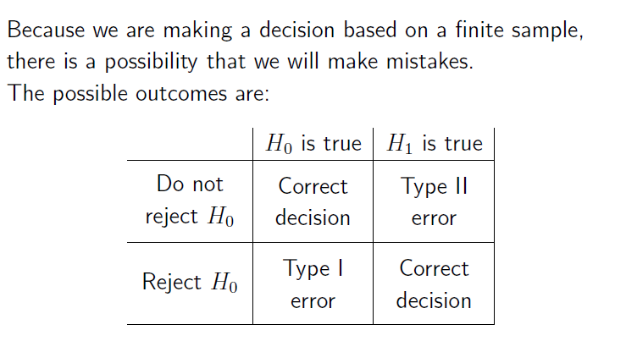
A Type I error means rejecting the null hypothesis when it's actually true, while a Type II error means failing to reject the null hypothesis when it's actually false

Slide 86
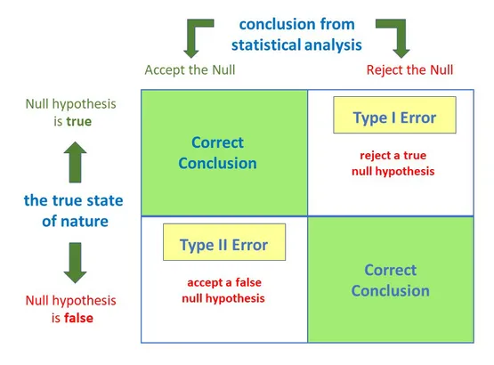
Type 1 False Positive Type 2 False negative

Slide 87
Type 1
The acceptance of H1 when H0 is true is called a Type I error.
The probability of committing a type I error is called the level of significance and is denoted by alpha.

Slide 88
Type 2
Failure to reject H0 when H1 is true is called a Type II error.
The probability of committing a type II error is denoted by beta.

Slide 89
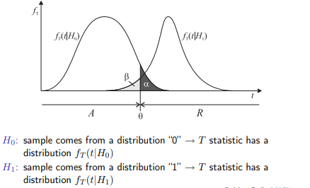

Slide 90
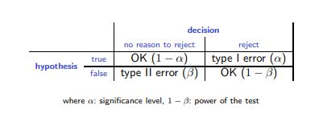

Slide 91
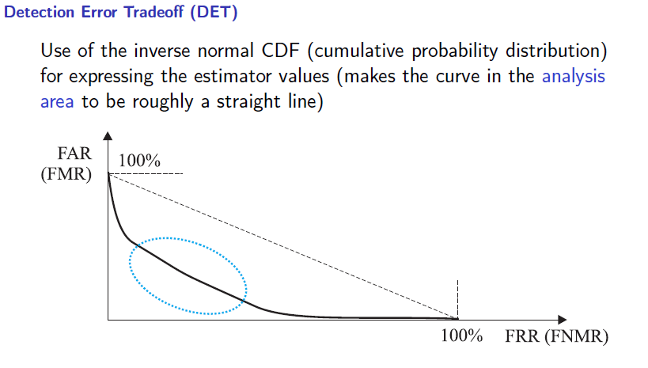
DET -- A detection error tradeoff (DET) graph is a graphical plot of error rates for binary classification systems, plotting the false rejection rate vs. false acceptance rate. DET curves give the user direct feedback of the detection error tradeoff to aid in operating point analysis. The user can deduct directly from the DET-curve plot at which rate false-negative error rate will improve when willing to accept an increase in false-positive error rate (or vice-versa).

Slide 92
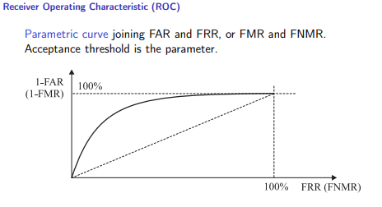
ROC

Slide 93
Feature Matching and Decision Making

Slide 94
Matching
Matcher is a system that takes two samples of biometric data and returns a score that indicates their similarity and dissimilarity
Similarity and dissimilarity measures highly depends on
- data acquisition device
- precision of representation of biometric samples
- degree of uniqueness of the samples over time etc

Slide 95
Kinds of errors
Given two biometric samples we can have two possible hypothesis
-Null hypothesis H0 => two samples are matching
- Alternative hypothesis H1 => two samples are not matching
Definition of hypothesis depends on biometric applications.
- different application can have different definition of errors.
But matching engine decides whether H0 is true or H1 is true.

Slide 96
Terminology
A biometric verification system makes two types of errors:
(i) mistaking biometric measurements from two different persons to be from the same person (called false match),
(ii) mistaking two biometric measurements from the same person to be from two different persons (called false non-match).
These two types of errors are often termed as false accept and false reject, respectively.

Slide 97
Terminology
The frequency with which this False Match occurs is called False match rate (FMR) or False Acceptance rate (FAR) or Type – I error.
The frequency with which this False Non Match occurs is called False non match rate (FNMR) or False rejection rate (FAR) or Type – II error.

Slide 98
Terminology
The system performance at all the operating points (thresholds, t) can be depicted in the form of a Receiver Operating Characteristic (ROC) curve.
A ROC curve is a plot of FMR against (1-FNMR) or FNMR for various threshold values, t

Slide 99
Mathematically the errors in a verification system can be formulated as follows. If the stored biometric template of the user I is represented by XI and the acquired input for recognition is represented by XQ, then the null and alternate hypotheses are:
H0: input XQ does not come from the same person as the template XI;
H1: input XQ comes from the same person as the template XI.
The associated decisions are as follows:
D0: person is not who she claims to be;
D1: person is who she claims to be.
The decision rule is as follows: if the matching score S(XQ, XI) is less than the system threshold t, then decide D0, else decide D1.

Slide 100
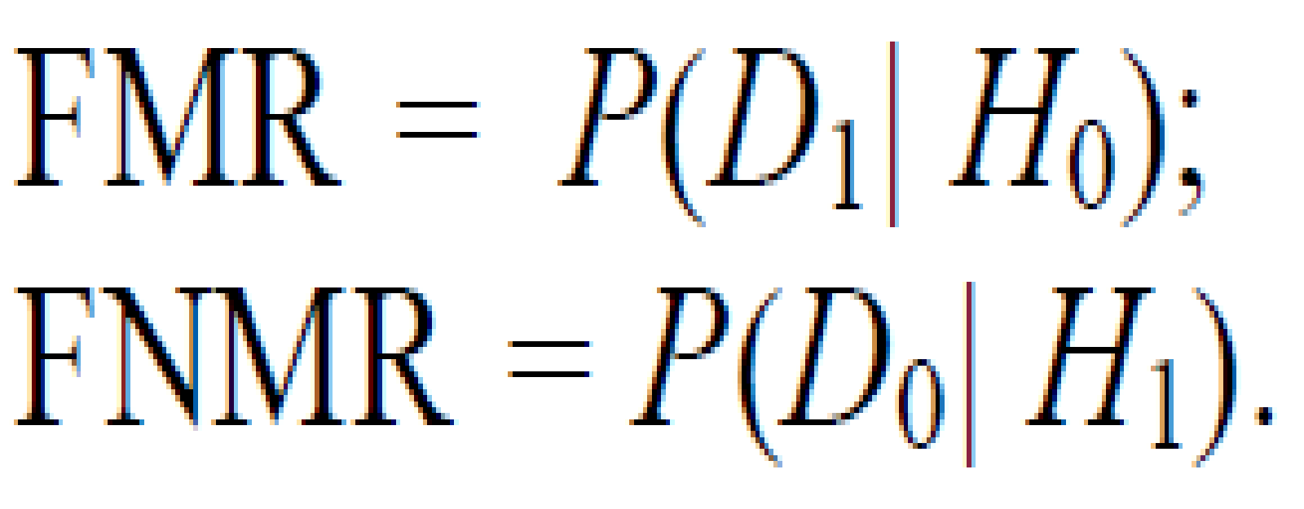
Type I: false match (D1 is decided when H0 is true);
Type II: false non-match (D0 is decided when H1 is true).
FMR is the probability of type I error (also called significance level in hypothesis testing) and FNMR is the probability of type II error:
The expression (1-FNMR) is also called the power of the hypothesis test.

Slide 101
Match Score distribution
If S is the similarity measure between two biometric samples, then we decide H0 is True if S > t (threshold), otherwise H1 is true.
Decision becomes sometimes very hard as there is no scope to tell “do not know” or “too close”.
This is known as decision making without exception handling
Reliability of the score is influenced by many factors :
Variations in sensors
Variations in data acquisition
Variations in data representation

Slide 102
Observations
Even though two samples are from identical biometric, the similarity score is rarely 1, unless two samples are copies of each other. But the score is usually high (i.e) Match score or genuine score for identical individual tend to be high.
Even though two samples are from different individuals, the score is not ZERO. But the score is usually low . (i.e) Non match score or imposter scores for two different individuals tend to be low.

Slide 103
Error rates
To evaluate the accuracy of a fingerprint biometric system, one must collect scores generated from multiple images of the same finger (the distribution p(S(XQ, XI)|H1)), and scores generated from a number of images from different fingers (the distribution p(S(XQ, XI)|H0))

Slide 104
Error rates
For biometric application, Match score distribution and non match score distribution always overlap.
It is not possible to select a t (threshold) such that FMR = 0 and FNMR = 0.
it should be selected in a such a way that system operates in optimal fashion.
FMR and FNMR are inversely related.
There is a trade-off between false match rate (FMR) and false non-match rate (FNMR) in every biometric system.
In fact, both FMR and FNMR are functions of the system threshold t; if t is decreased to make the system more tolerant to input variations and noise, then FMR increases.
On the other hand, if t is raised to make the system more secure, then FNMR increases accordingly.

Slide 105
Receiver Operating Curve
Suppose the integrals can be computed for any t.
Then, FMR(t) and FNMR(t) give error rates when the match decision is made at some t
These errors can be plotted against each other as a two dimensional curve
ROC(t) = (FMR(t),FNMR(t))
That is, FMR and FNMR behaviour is expressed in terms of ROC curve.

Slide 106
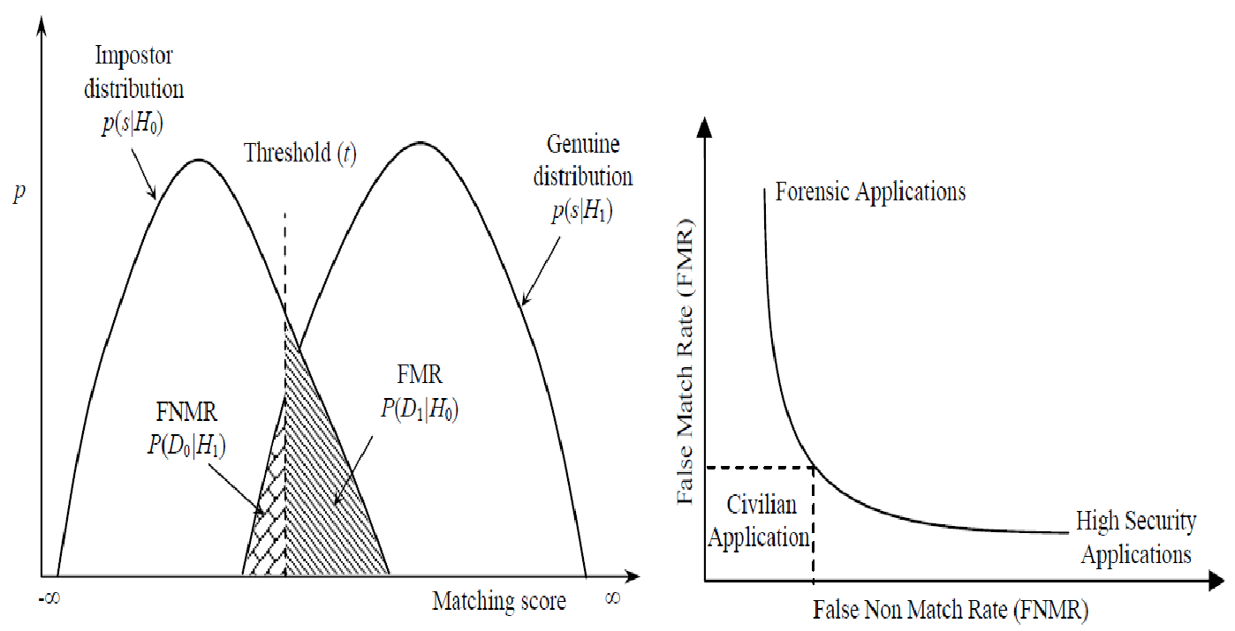
ROC curve and FAR/FRR curve

Slide 107
ROC
When t is set low, FMR is high and FNMR is low; conversely when t is high FNMR is high and FMR is low
Thus the matcher can be operated using any threshold t which defines a point on ROC. This is known as Operating Point of the matcher.
The operating point can be specified by choosing any one of t, FMR and FNMR.

Slide 108
Variations of ROC
There are number of variations of ROCs that are used expressing the information
One way is already shown.
Others can be obtained by plotting one or both the probabilities on a logarithmic scale.
Sometimes one plots Correct Match Rate [ i.e 1-FNMR] against FMR. This is called Detection Error Trade-off (DET) curve.
Along y-axis we have [1-FNMR] which is correct detection rate and along x-axis we put FMR [False Alarm Rate]
Detection rate goes to 1 when false alarm rate goes to 1..

Slide 109
1
T -> -∞
Detection Rate
T -> ∞
0
1
False Alarm Rate

Slide 110
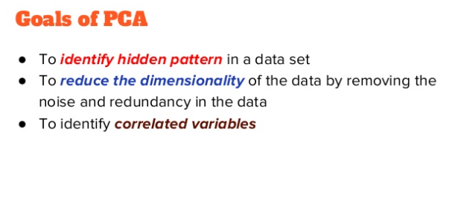
PCA

Slide 111
PCA finds a new set of dimensions (or a set of basis of views) such that all the dimensions are orthogonal (and hence linearly independent) and ranked according to the variance of data along them. It means more important principle axis occurs first. (more important = more variance/more spread out data)

Slide 112
How does PCA work
Calculate the covariance matrix X of data points.
Calculate eigen vectors and corresponding eigen values.
Sort the eigen vectors according to their eigen values in decreasing order.
Choose first k eigen vectors and that will be the new k dimensions.
Transform the original n dimensional data points into k dimensions.

Slide 113
the goal of PCA
Find linearly independent dimensions (or basis of views) which can losslessly represent the data points.
Those newly found dimensions should allow us to predict/reconstruct the original dimensions. The reconstruction/projection error should be minimized.

Slide 114
Steps
Standardize the data.
Compute the covariance matrix of the features from the dataset.
Perform eigendecompositon on the covariance matrix.
Order the eigenvectors in decreasing order based on the magnitude of their corresponding eigenvalues.
Determine k, the number of top principal components to select.
Construct the projection matrix from the chosen number of top principal components.
Compute the new k-dimensional feature space.

Slide 115
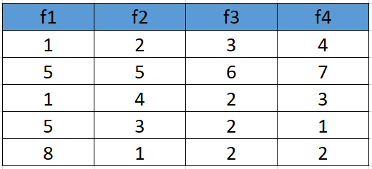
1. Standardize the Dataset
Assume we have the below dataset which has 4 features and a total of 5 training examples.

Slide 116
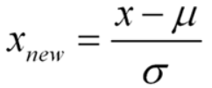
First, we need to standardize the dataset and for that, we need to calculate the mean and standard deviation for each feature.

Slide 117
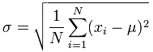
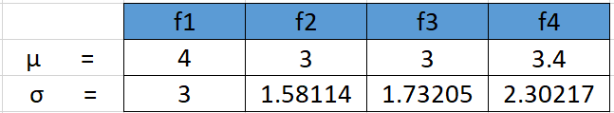

Slide 118
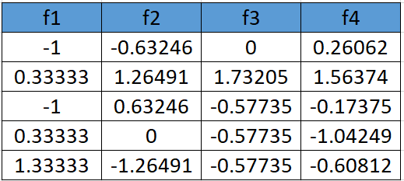
After applying the formula for each feature in the dataset is transformed as below:

Slide 119
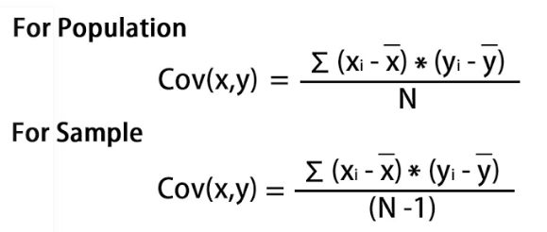
Calculate the covariance matrix for the whole dataset

Slide 120
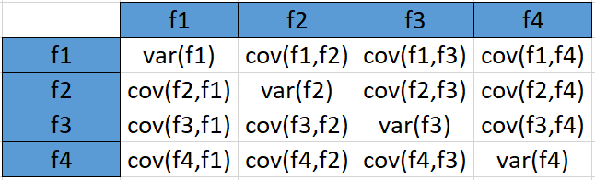
the covariance matrix for the given dataset will be calculated as below

Slide 121
Since we have standardized the dataset, so the mean for each feature is 0 and the standard deviation is 1.
var(f1) = ((-1.0-0)² + (0.33-0)² + (-1.0-0)² +(0.33–0)² +(1.33–0)²)/5 var (f1) = 0.8
cov(f1,f2) = ((-1.0–0)*(-0.632456-0) + (0.33–0)*(1.264911-0) + (-1.0–0)* (0.632456-0)+ (0.33–0)*(0.000000 -0)+ (1.33–0)*(-1.264911–0))/5 cov(f1,f2 = -0.25298

Slide 122
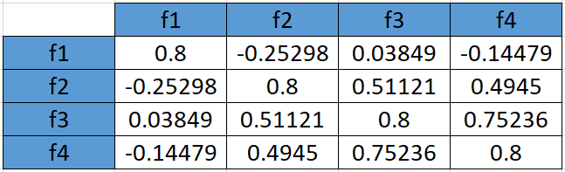
In the similar way be can calculate the other covariances and which will result in the below covariance matrix

Slide 123
Calculate eigenvalues and eigen vectors.
An eigenvector is a nonzero vector that changes at most by a scalar factor when that linear transformation is applied to it. The corresponding eigenvalue is the factor by which the eigenvector is scaled.
Let A be a square matrix (in our case the covariance matrix), ν a vector and λ a scalar that satisfies Aν = λν, then λ is called eigenvalue associated with eigenvector ν of A. Rearranging the above equation,

Slide 124

Aν-λν =0 ; (A-λI)ν = 0
Since we have already know ν is a non- zero vector, only way this equation can be equal to zero, if
det(A-λI) = 0

Slide 125
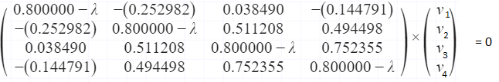
Solving the above equation = 0
λ = 2.51579324 , 1.0652885 , 0.39388704 , 0.02503121
Eigenvectors:
Solving the (A-λI)ν = 0 equation for ν vector with different λ values:

Slide 126
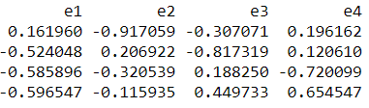
Going by the same approach, we can calculate the eigen vectors for the other eigen values. We can from a matrix using the eigen vectors.
For λ = 2.51579324, solving the above equation using Cramer's rule, the values for v vector are
v1 = 0.16195986 v2 = -0.52404813 v3 = -0.58589647 v4 = -0.59654663
eigenvectors(4 * 4 matrix)

Slide 127

4. Sort eigenvalues and their corresponding eigenvectors.
Since eigenvalues are already sorted in this case so no need to sort them again.
5. Pick k eigenvalues and form a matrix of eigenvectors
if we choose the top 2 eigenvectors, the matrix will look like this:
If we choose the top 2 eigenvectors, the matrix will look like this:
Top 2 eigenvectors(4*2 matrix)
Feature matrix * top k eigenvectors = Transformed Data

Slide 128

6. Transform the original matrix.
Feature matrix * top k eigenvectors = Transformed Data

Slide 129
Eigenvectors and eigenvalues
The eigenvectors and eigenvalues of a covariance (or correlation) matrix represent the “core” of a PCA: The eigenvectors (principal components) determine the directions of the new feature space, and the eigenvalues determine their magnitude.
Deduce the Eigens:
Suppose we have plotted a scatter plot of random variables, and a line of best fit is drawn between these points. This line of best fit, shows the direction of maximum variance in the dataset. The Eigenvector is the direction of that line, while the eigenvalue is a number that tells us how the data set is spread out on the line which is an Eigenvector.

Slide 130


Slide 131

The main principal component, depicted by the black line, is the first Eigenvector. The second Eigenvector will be perpendicular or orthogonal to the first one. The reason the two Eigenvectors are orthogonal to each other is because the Eigenvectors should be able to span the whole x-y area. Naturally, a line perpendicular to the black line will be our new Y axis, the other principal component.

Slide 132
We are going to rotate our data to fit these new axes. But what will the coordinates of the rotated data be?
To convert the data into the new axes, we will multiply the original X, Y data by Eigenvectors, which indicate the direction of the new axes (principal components).
But first, we need to deduce the Eigenvectors (there are two — one per axis). Each Eigenvector will correspond to an Eigenvalue, whose magnitude indicates how much of the data’s variability is explained by its Eigenvector.
From the definition of Eigenvalue and Eigenvector:
[Covariance matrix].[Eigenvector] = [Eigenvalue].[Eigenvector]

Slide 133


Slide 134


Slide 135


Slide 137


Slide 138


Slide 139


Slide 140


Slide 141


Slide 142


Slide 143


Slide 144


Slide 145
Linear Discriminant Analysis

Slide 146
Introduction
Linear Discriminant Analysis or LDA is a dimensionality reduction technique.
It is used as a pre-processing step in Machine Learning and applications of pattern classification.
The goal of LDA is to project the features in higher dimensional space onto a lower-dimensional space in order to avoid the curse of dimensionality and also reduce resources and dimensional costs.

Slide 147
Both LDA and PCA are linear transformation techniques: LDA is a supervised whereas PCA is unsupervised – PCA ignores class labels. ... In contrast to PCA, LDA attempts to find a feature subspace that maximizes class separability

Slide 148
Dimensionality Reduction
The techniques of dimensionality reduction are important in applications of Machine Learning, Data Mining, Bioinformatics, and Information Retrieval.
The main agenda is to remove the redundant and dependent features by changing the dataset onto a lower-dimensional space.
In simple terms, they reduce the dimensions (i.e. variables) in a particular dataset while retaining most of the data.

Slide 149

Practical approach to an LDA model
Consider a situation where you have plotted the relationship between two variables where each color represents a different class. One is shown with a red color and the other with blue.

Slide 150

Practical approach to an LDA model
If you are willing to reduce the number of dimensions to 1, you can just project everything to the x-axis as shown below:
This approach neglects any helpful information provided by the second feature. However, you can use LDA to plot it.

Slide 151



Practical approach to an LDA model
The advantage of LDA is that it uses information from both the features to create a new axis which in turn minimizes the variance and maximizes the class distance of the two variables.

Slide 152


How it works
LDA focuses primarily on projecting the features in higher dimension space to lower dimensions. You can achieve this in three steps:
Firstly, you need to calculate the separability between classes which is the distance between the mean of different classes. This is called the between-class variance.
Secondly, calculate the distance between the mean and sample of each class. It is also called the within-class variance.

Slide 153

How it works
Finally, construct the lower-dimensional space which maximizes the between-class variance and minimizes the within-class variance. P is considered as the lower-dimensional space projection, also called Fisher’s criterion.

Slide 154
How does an LDA model make predictions?
LDA models use Bayes’ Theorem to estimate probabilities. They make predictions based upon the probability that a new input dataset belongs to each class.
The class which has the highest probability is considered the output class and then the LDA makes a prediction.
The prediction is made simply by the use of Bayes’ Theorem which estimates the probability of the output class given the input.

Slide 155
How does an LDA model make predictions?
They also make use of the probability of each class and the probability of the data belonging to each class:
P(Y=x|X=x) = [(Plk * fk(x))] / [(sum(PlI * fl(x))]
Where x = input. k = output class. Plk = Nk/n or base probability of each class observed in the training data. It is also called prior probability in Bayes’ Theorem. fk(x) = estimated probability of x belonging to class k.
The f(x) is plotted using a Gaussian Distribution function and then it is plugged into the equation above and the result we get is the equation as follows:
Dk(x) = x∗(mean/Σ²) – (mean²/(2*Σ²)) + ln(PIk)
The Dk(x) is called the discriminant function for class k given input x, mean, Σ² and Plk are all estimated from the data and the class is calculated as having the largest value, will be considered in the output classification.

Slide 156
What is decision theory?
Decision theory is theory about decisions.
The subject is not a very unified one.
To the contrary, there are many different ways to theorize about decisions, and therefore also many different research traditions.
This text attempts to reflect some of the diversity of the subject. Its emphasis lies on the less (mathematically) technical aspects of decision theory.

Slide 157
Decision theory (or the theory of choice not to be confused with choice theory) is the study of an agent's choices.
Decision theory can be broken into two branches:
normative
descriptive

Slide 158
Two types
normative decision theory, which analyzes the outcomes of decisions or determines the optimal decisions given constraints and assumptions
descriptive decision theory, which analyzes how agents actually make the decisions they do.

Slide 159


Slide 160


Slide 161


Slide 162


Slide 163


Slide 164


Slide 165


Slide 166


Slide 167


Slide 168


Slide 169


Slide 171


Slide 172


Slide 173


Slide 174


Slide 175


Slide 176


